Slide 1




Slide 2
Seminar Presentation
GRADIENT DESCENT
Presented By:
AAKASH YADAV , SAPID : 590020652
SHIVANSH GUPTA, SAPID : 590020656
BHAWANI SINGH, SAPID : 590020666
GARV BHARGAVA , SAPID : 590020664
Mentor :
Prof. J. DHIVIYA ROSE
School of Computer Science | UPES

Slide 3

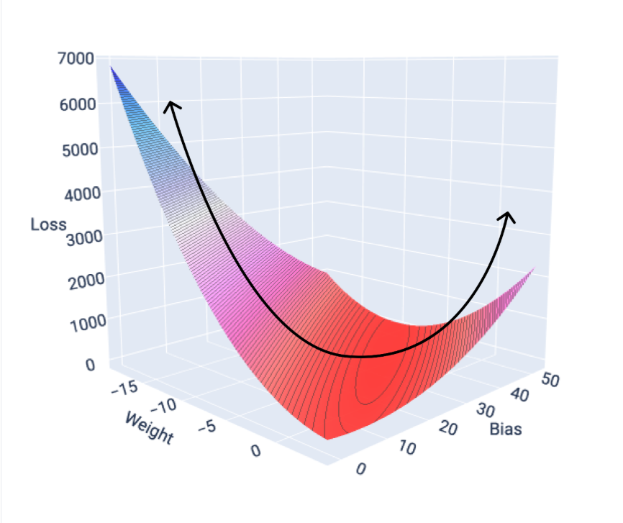
GRADIENT
DESCENT
A brief overview

Slide 4
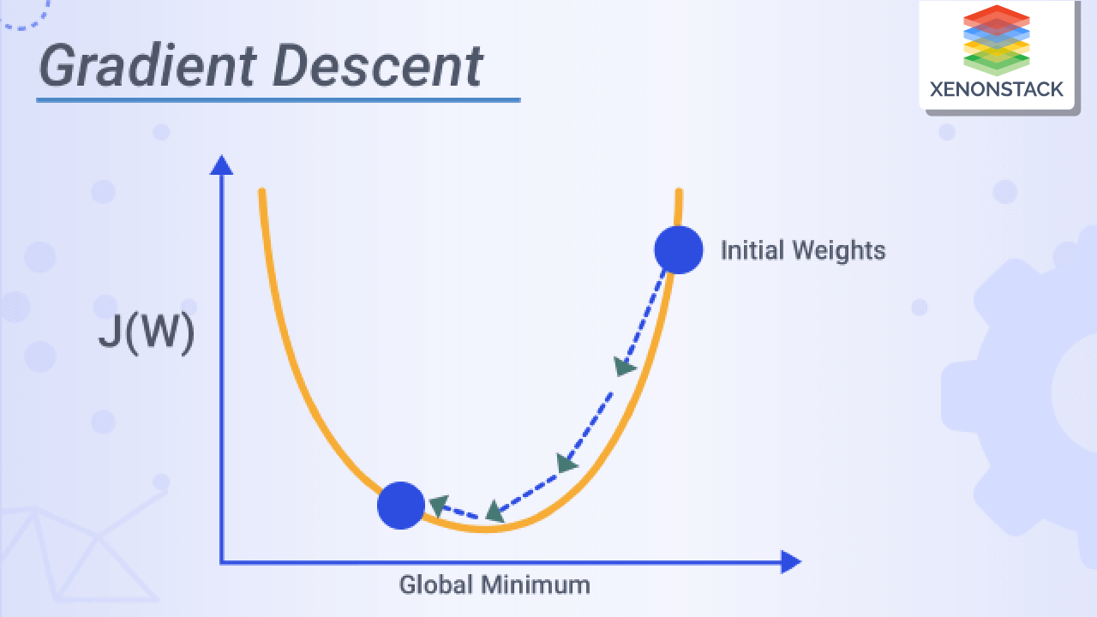
Agenda
What is gradient descent?
How Gradient descent works?
Types of Gradient descent
Comparison of types of GD
Terminology related to GD

Slide 5
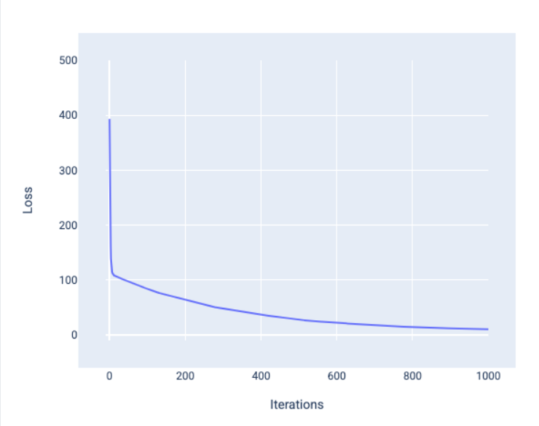
What is Gradient Descent?
Optimization Algorithm
Gradient descent is a mathematical technique that iteratively finds the weights and bias that produce the model with the lowest loss.

Slide 6
How Gradient Descent Works ?
The Core Idea: In machine learning, we want to find the best parameters (like weights and biases) for our model.
"Best" means the parameters that minimize a "cost" or "loss" function.
Think of the cost function as a measure of how wrong our model's predictions are. Our goal is to make the model as "not-wrong" as possible.
Goal: Find the lowest point of the cost function.

Slide 7
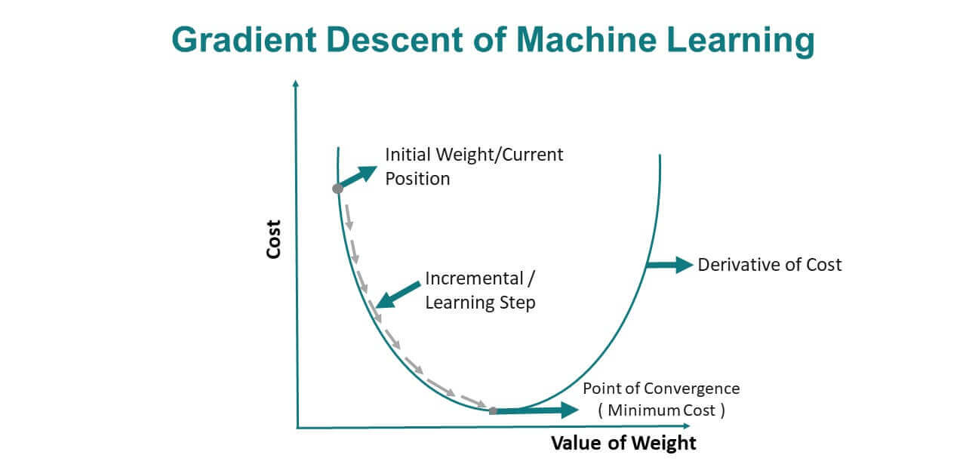

Slide 8
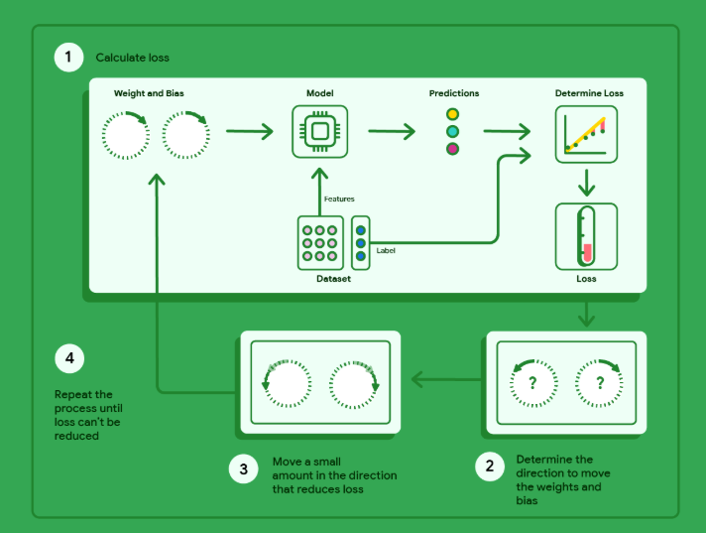

Slide 9
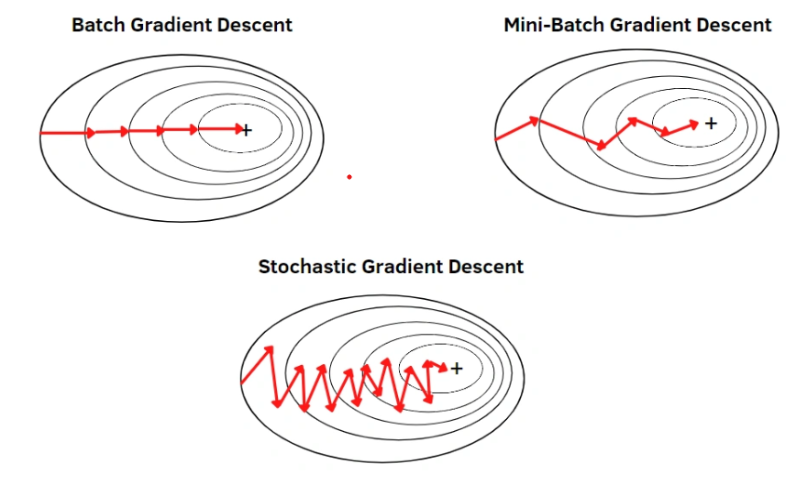

Type of Gradient Decent
1. Batch Gradient Descent (BGD)
2. Stochastic Gradient Descent (SGD)
3. Mini-Batch Gradient Descent

Slide 10
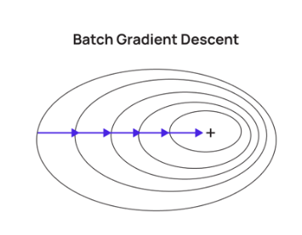
Quote
1. Batch Gradient Descent (BGD)
optimization algorithm that updates model parameters using the entire training dataset to compute the gradient of the cost/loss function
Pros:
  Stable convergence.
  More accurate gradient estimate.
Cons:
  Slow with large datasets.
  High memory consumption.
Use : Small to medium datasets.

Slide 11
Quote
Working of Batch Gradient Descent
Lets take Dataset of 1000 samples and 20 epochs
Epoch : processing all samples once
For every epoch the function will calculate the error and update weight and Bias once to achieve best fit line
It will take all the samples in every Epochs
And updating weight and Bias equal to the no of epochs
20 times

Slide 12
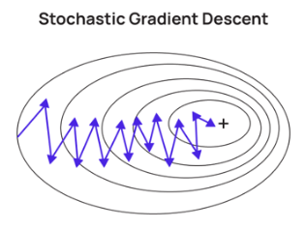
2. Stochastic Gradient Descent (SGD)
an optimization algorithm that updates model parameters using only one training example at a time to compute the gradient of the loss function
Pros:
Faster updates (good for large datasets).
Can escape local minima due to its noisy nature.
Cons:
Noisy updates may never converge exactly.
More fluctuation in loss.
Use : Online learning, large datasets

Slide 13
Working of Stochastic Gradient Descent
Lets take Dataset of 1000 samples and 20 epochs
For every sample the function will calculate and update weight and Bias once to achieve best fit line
the updates of weights and bias will be
(no of samples *epochs)
20,000 times.

Slide 14
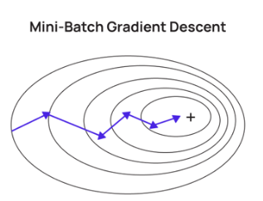
Quote
3.Mini Batch Gradient Descent (BGD)
a variant of gradient descent where the model updates its parameters using a small, random subset (batch) of the training data instead of using the entire dataset (Batch GD) or a single example (SGD).
Pros:
Balance between BGD and SGD.
Faster convergence than BGD.
Less noisy than SGD.
Cons:
Requires tuning of mini-batch size.
Use : Most deep learning models.

Slide 15
Quote
Working of Mini Batch Gradient Descent
Lets take Dataset of 1000 samples ,20 epochs and
Batch size 50(50 samples from dataset in 1 batch)
No of batches=1000/50 = 20
For every epoch the function will calculate the error and update weight and Bias for all the samples in all batches once to achieve best fit line
It will take all the batches in every Epochs
And updating weight and Bias equal to (no of epochs*batch size)
50*20 = 1000

Slide 16
COMPARISON OF TYPES OF GRADIENT DESCENTS

Slide 17
HOW DO THEY DIFFER FROM EACH OTHER?
Feature | Batch GD | SGD | Mini-Batch GD
Data per update | All data | 1 sample | Few samples
Speed | Slow | Fast | Moderate
Convergence path | Smooth | Noisy | Balanced
Memory usage | High | Low | Moderate
Use case | Small datasets | Very large datasets | Most practical ML models

Slide 18
Gradient Descent Code Implementation
import pandas as pd
import numpy as np
import matplotlib.pyplot as plt
# 1. Load dataset
data = pd.read_csv("salary_data.csv") # Make sure salary_data.csv is in your working directory
X = data["YearsExperience"].values.reshape(-1, 1)
y = data["Salary"].values

Slide 19
def gradient_descent(X, y, lr, epochs, gd_type, batch_size):
"""
Unified Gradient Descent implementation.
Parameters:
X : -> features
y : -> target values
lr : float, learning rate
epochs : int, number of iterations
gd_type : str, "batch", "stochastic", or "mini-batch"
batch_size: int, size of mini-batch (used if gd_type == "mini-batch")
Returns:
w, b : final weight and bias for lowest loss
"""
#1)
m = len(y) # number of samples
w, b = 0.0, 0.0 # initialize parameters
X = X.reshape(-1) # ensure 1D
y = y.reshape(-1) # ensure 1D
#2) loop for iterations for calculation of weight and loss
for epoch in range(epochs):
if gd_type == "batch":
# Use all data for gradient
y_pred = w * X + b
dw = -(2/m) * np.sum(X * (y - y_pred))
db = -(2/m) * np.sum(y - y_pred)
w -= lr * dw
b -= lr * db

Slide 20
#for stochastic batch gradient
elif gd_type == "stochastic":
# Loop over each sample
for i in range(m):
xi, yi = X[i], y[i]
y_pred = w * xi + b
dw = -(2) * xi * (yi - y_pred)
db = -(2) * (yi - y_pred)
w -= lr * dw
b -= lr * db
#for mini batch gradient descent
elif gd_type == "mini-batch":
# Shuffle indices
indices = np.random.permutation(m)
X_shuffled, y_shuffled = X[indices], y[indices]
for i in range(0, m, batch_size):
X_batch = X_shuffled[i:i+batch_size]
y_batch = y_shuffled[i:i+batch_size]
y_pred = w * X_batch + b
dw = -(2/len(y_batch)) * np.sum(X_batch * (y_batch - y_pred))
db = -(2/len(y_batch)) * np.sum(y_batch - y_pred)
w -= lr * dw
b -= lr * db
#returning weight and bias
return w, b

Slide 21
# 2. Train using gradient descent
w, b = gradient_descent(X, y, lr=0.01, epochs=1000, batch_type="batch" )
print(f"\nFinal Model: Salary = {w:.2f} * Experience + {b:.2f}")
# 3. Plot results
plt.scatter(X, y, color="blue", label="Data points")
plt.plot(X, w*X + b, color="red", label="Best Fit Line")
plt.xlabel("Years of Experience")
plt.ylabel("Salary")
plt.legend()
plt.show()

Slide 22
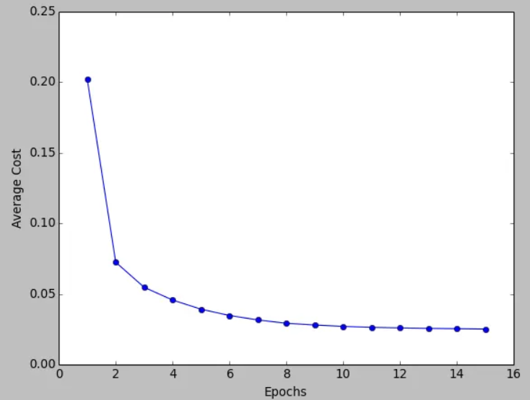
Quote
BATCH GRADIENT DESCENT
# Run Batch GD
print("\n--- Batch Gradient Descent ---")
w1, b1 = gradient_descent(X, y, lr=0.01, epochs=1000, gd_type="batch")
SMOOTH CURVE
GOOD FOR SMALLER DATASETS
OFFLINE TRAINING

Slide 23
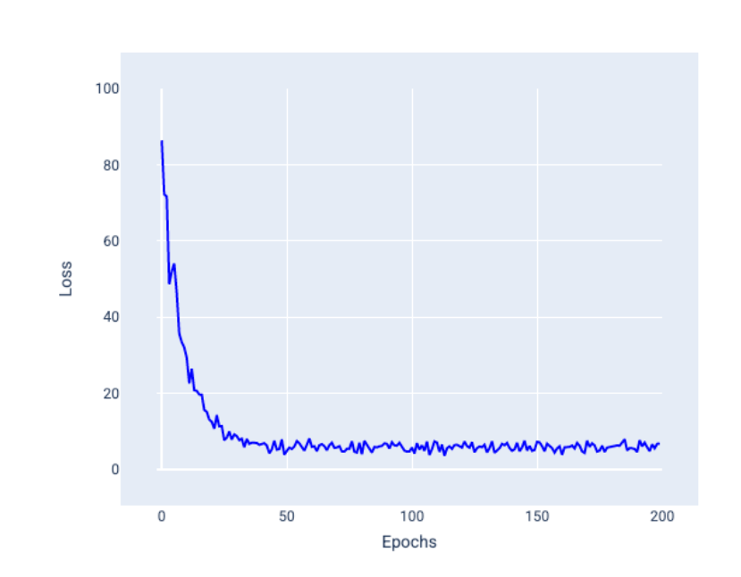
Quote
Stochastic gradient descent (SGD)
# Run SGD
print("\n--- Stochastic Gradient Descent ---")
w2, b2 = gradient_descent(X, y, lr=0.01, epochs=1000, gd_type="stochastic")
ZIG ZAG PATH
ONLINE LEARNING
STREAMING DATA

Slide 24
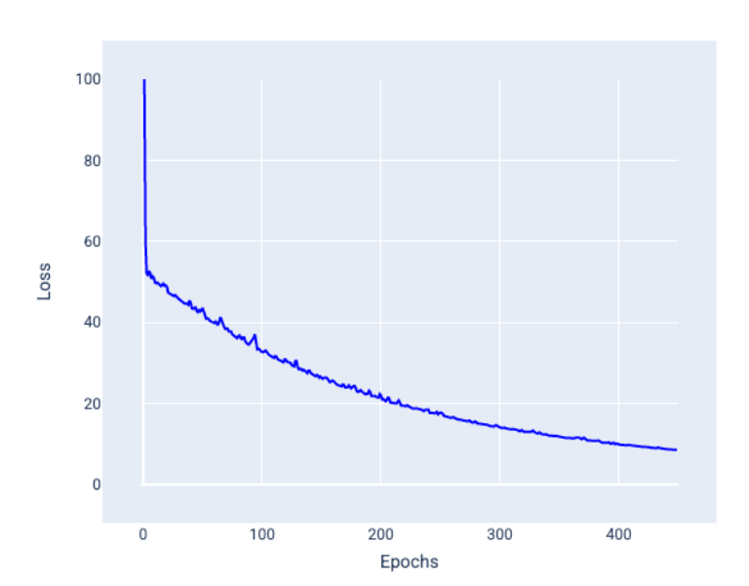
Quote
Mini-batch stochastic gradient descent (mini-batch SGD)
# Run Mini-Batch GD
print("\n--- Mini-Batch Gradient Descent ---")
w3, b3 = gradient_descent(X, y, lr=0.01, epochs=1000, gd_type="mini-batch", batch_size=16)
MODERATE FLUCTUATIONS
DEEP LEARNING
MOST WIDELY USED IN PRACTICE

Slide 25
Quote
Terminology
Gradient Descent : An optimization algorithm that updates model parameter i.e. weight and bias step by step in the direction that reduces the cost function, until it reaches the minimum.
Weights : The coefficients multiplied with input features that determines their importance in prediction.
Bias : A constant term added to shift the prediction line/curve up or down, independent of input feature.
Overfitting : When a model learns the training data too well, including noise and details, leading to poor performance on unseen data.
Underfitting : When a model is too simple and fails to capture the underlying patterns in the training data, leading to poor performance on both training and test data.
Learning Rate : A hyperparameter that controls the size of the steps taken during updates in gradient descent.
Cost Function : A function that measures how well the entire model is performing by averaging the errors across all training data points. Eg : MSE (Mean square error)
Loss Function : A function that measures the error for a single training example. The cost function is the average of the loss function across all data points

Slide 26
THANK YOU

